Slide 1

Rockbuster Stealth LLC Data Analysis for online launching
Made by Lara Ljumovic
Sep 18th 2023

Slide 2
Introduction and Objectives
WHO?
Rockbuster Stealth LLC is movie rental company that used to have stores around the world.
WHY?
Facing stiff competition from streaming services the Rockbuster Stealth management team is planning to use its existing movie licenses to launch an online video rental service to stay competitive.
KEY BUSINESS QUESTIONS
Which movies contributed the most/least to revenue gain?
What was the average rental duration for all videos?
Which countries are Rockbuster customers based in?
Where are customers with a high lifetime value based?
Do sales figures vary between geographic regions?
What are the most popular movie genres?

Slide 3
Movie database overview
MOVIES
1000 MOVIES
17 GENRES
5 MPAA RATINGS
ALL MOVIES
* were released in 2006
* have English language
CUSTOMERS
584 ACTIVE
CUSTOMERS
in
109 COUNTRIES
and
599 CITIES
RENTALS
$ 61312.04
TOTAL REVENUE
and
16044
TOTAL RENTALS

Slide 4
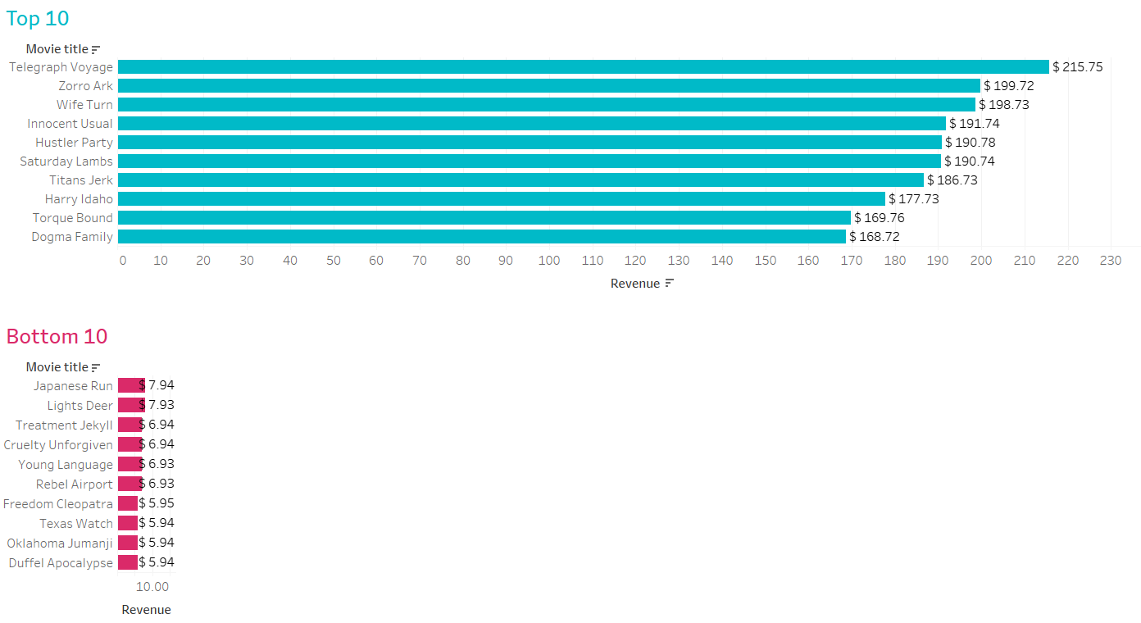
Movie contribution to revenue
Top 50 movies contributed to 13% of global revenue
Most top listed movies have rental rate $ 4.99
Bottom 50 movies contributed to 1% of global revenue
Most bottom listed movies have rental rate $ 0.99

Slide 5
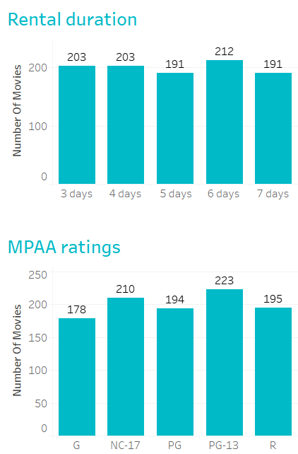
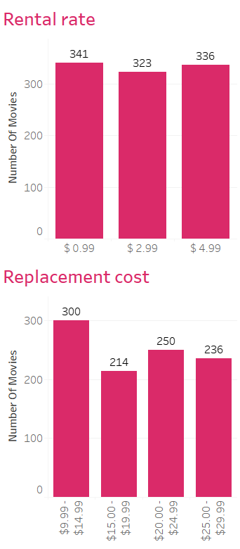
Key statistics for all movies
MIN 3 days
MAX 7 days
Average 5 days
Most common
PG-13
MIN $0.99
MAX $4.99
Average $2.98
MIN $9.99
MAX $29.99
Average $19.98

Slide 6
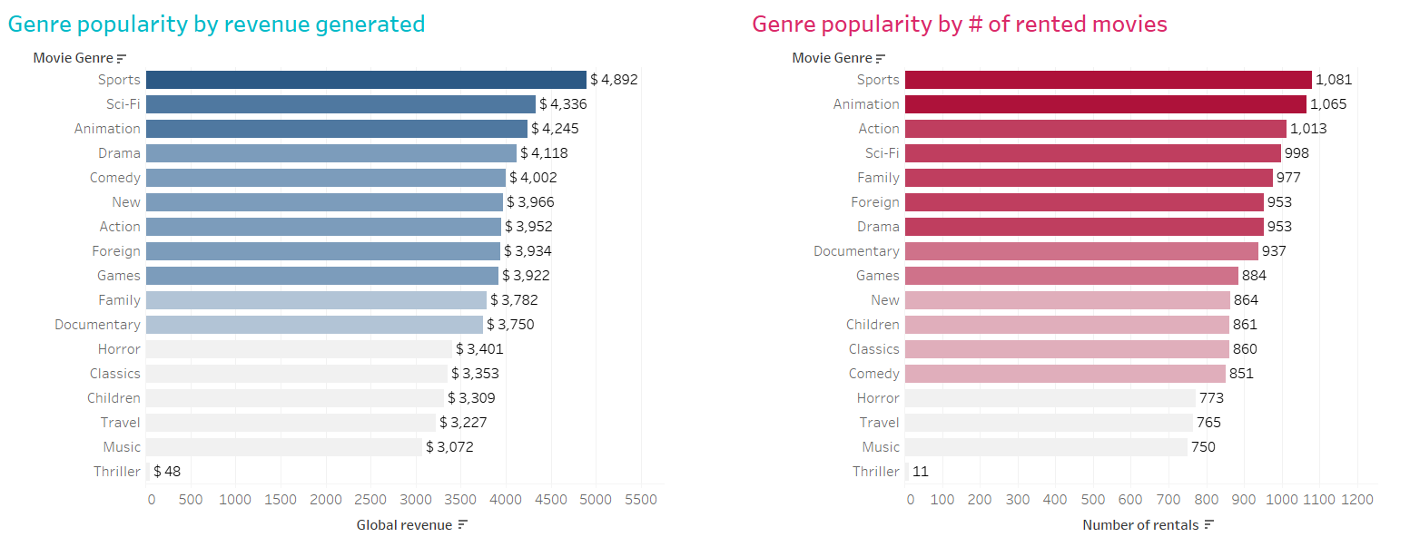
Genre popularity worldwide
Top 3
Sports
Sci-fi
Animation
Bottom 3
Thriller
Music
Travel
Top 3
Sports
Animation
Action
Bottom 3
Thriller
Music
Travel
Note: There is only 1 thriller movie in database

Slide 7
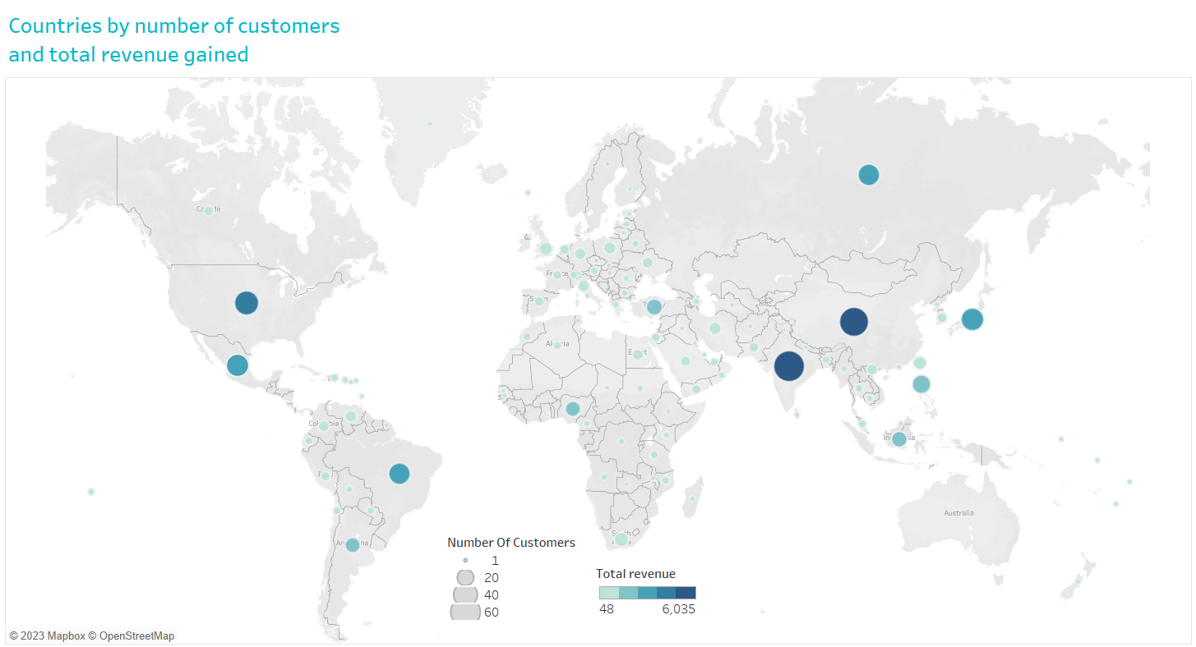
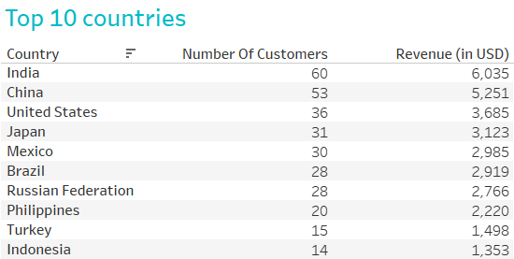
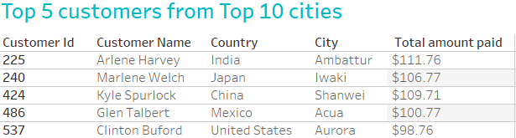
Spatial analysis
Same countries are in Top 10 by number of customers and by revenue gain.
There is a strong correlation between number of customers in country and revenue it generates.

Slide 8
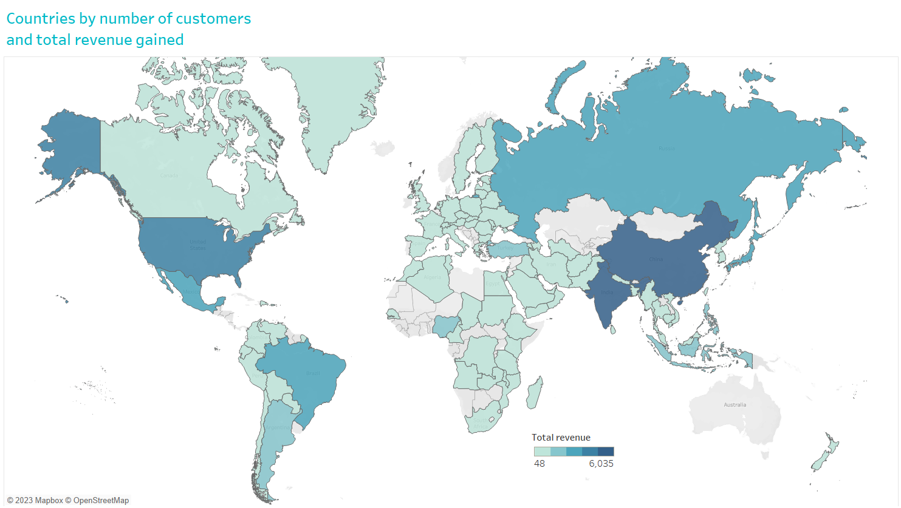
Sales by regions
Percentage of global sales
per each continent:
Asia 45%
Europe 18%
South America 13%
North Amerika 12%
Africa 11%
Oceania 1%
Asia dominates the market with almost half of global revenue generated.
No data for Australia leaves continent Oceania with very poor performance results.

Slide 9
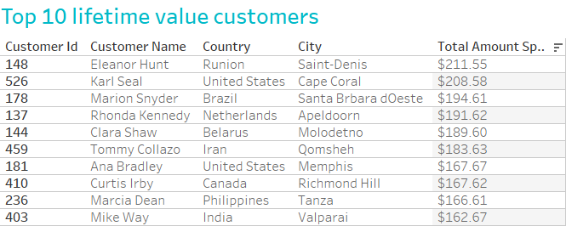
Lifetime value customers
Only 5 customers comes from Top 10 revenue countries.

Slide 10
Recommendations
Movie inventory should be pruned to exclude movies that don’t generate high revenue (Bottom 50 or even more).
Profitability of movies should be investigated in more detail.
Is cost of replacement much lower that revenue it generates?
Marketing should focus first on top 10 countries with currently highest revenue to attract even more customers (More customers = More revenue).
Customers that have high value should be reworded with free rentals.
Some affiliate program could generate more profit too.

Slide 11
Questions?
Link for Tableau Public:
Rockbuster visualizations | Tableau Public

